Slide 1
Item #18
Stakeholder Management of SAI South Africa which is core in implementing ISSAI 12 principle
Charles Baloyi
Auditor-General of South Africa
20 September 2018

Slide 2
Key developments in AGSA stakeholder strategy
Since a fundamental revision of AGSA strategy in 2001 the AGSA has –
Recognised that our reports had a direct impact on the reputation of the AGSA
identified communication and stakeholder management as a key success factor,
Acknowledged importance of regular, professional relationships with all stakeholders;
Recognised importance of feedback from stakeholders,
Focussing on providing stakeholders with messages that supports the accountability chain and facilitates good governance of public funds
Formulated and implemented frameworks, policies and procedures that guides stakeholder interaction

Slide 3
Stakeholder management frameworks and policies
The Constitutional Stakeholder Policies outlines the key AGSA stakeholders and enforces engagement at appropriate levels
Procedures provides step by step guidance on implementation and interaction planning tools
Identify and categorise key stakeholders
Analyse AGSA / stakeholder relationships
Plan engagements per category of stakeholder
Carry out quarterly and annual assessments and report
Engage regularly and monitor outcomes of engagements
Self-assessments is an organisational balanced scorecard requirement to determine if the planned engagements are having the desired impact so that adjustments can be made where needed
A stakeholder management information system module put in place to capture and monitor interactions, including a user guide

Slide 4
Frameworks, Policies and procedures
Constitutional Interaction Policy
MoU framework
Stakeholder Management Framework
Capacity building Policy

Slide 5
Frameworks, Policies and procedures
Scanning of environment procedure
Tabling of reports policy

Slide 6
Who are our stakeholders
Accountability
Authority- provide assurance for being credible knowledge experts.
Consensus- identify and share issues of consensus before discussing other matters.
Consistency-look for and ask commitments on actions that can be taken.
Reciprocity- offer assistance and availability to collaborate further.
Liking-share information that identifies commonalities and then negotiate for action to be taken.
Timeframes- agree on when you are available to interact and what you will be sharing with your stakeholders
Role of
AGSA

Slide 7
Who are our stakeholder
Auditees
Professional bodies
Audit Firms
Legislative authorities – Parliament Oversight
AGSA staff
Executive Authorities - Ministers

Slide 8
Spheres of government in South Africa
Constitution
Provincial
Local
National
In South Africa, there are three distinct spheres of government that the AGSA is mandated to Audit
The three spheres include National, Provincial and Local Government
The Constitution enshrines the principles of “separation of Powers”

Slide 9
Executive & Legislature

Slide 10
Legislature & Executive
Executive sphere
National government
Provincial government
Local government
Legislative sphere
National Assembly (NA)
National Council of Provinces (NCoP)
Provincial Legislatures
Municipal Councils

Slide 11
Three levels of AGSA leadership interaction
Annual interactions at highest stakeholder levels by the Auditor-General
Road shows and door-to-door visits
Coordinating ministries
Quarterly interactions with individual stakeholder leadership by corporate executives
Executive
Legislative
Partnership-based multilateral and bilateral interactions
E.g. national and provincial treasuries, Public Service Commission, Public Protector, and other Chapter 9s
(Ministers)
(Finance,
DPSA, COGTA,
Ministry (President’s Office)
(Premiers, MECs)

Slide 12
Executive stakeholder interaction
Stakeholder | TYPE OF EXECUTIVE INTERACTIONS | AGSA relationship owner
Cabinet and provincial executive council | Sharing of PFMA and MFMA audit outcomes | AG, Deputy AG & National Leader audit
Coordinating ministries | Follow up on audit transversal matters | Audit Research & Development & NL
Individual ministers and Members of Executive council (MEC) | Department-specific audit outcomes | Corporate Executives
Provincial executive council | Sharing of PFMA and MFMA audit outcomes | Corporate Executive and Business Executives
Individual MECs | Portfolio specific audit issues | Business executives
Mayor and Municipal Speakers | MFMA audit outcomes | BE, DBE and SM

Slide 13
Oversight stakeholder interactions: Parliament
Stakeholder | Type of executive interactions | AGSA relationship owner
NA/NCOP house chairpersons | Sharing of PFMA and MFMA audit outcomes | AG, DAG & NL
Committee of chairpersons | Sharing of PFMA and MFMA audit outcomes with the collective leadership | AG, CEs
Individual chairpersons | Department specific audit outcomes and key controls engagements on a quarterly basis | CEs
Chair of chairs | Sharing of PFMA and MFMA audit outcomes | CE and BE
Speaker of the legislature (national and provincial) | Sharing of PFMA and MFMA audit outcomes | CE and BE

Slide 14
Guidance in interacting with stakeholders
Develop Stakeholder Plan
Employee engagements
Workshop stakeholder plan, execution and reporting.
Update and monitor SMIS
Monitor, report and update on regular basis
Interactions & commitments on SMIS
Follow- up and revisit future initiatives
Compile monthly / quarterly report
Implementation
One-on-one sessions with key stakeholders on their expectations of AGSA.
Communicate needs to SMIS Support
Identify rationale for engagements
Identify and categorise stakeholders
Interaction on audit messages & others i.e capacity building
Identify frequency of interactions

Slide 15
Competencies for effective stakeholder engagement
Competency | Purpose
Clear understanding of the auditee’s environment and its dynamics | To enhance the confidence of both the executive authorities and oversight structures
Ability to communicate complex auditing terms in a simple, understandable way | To help the stakeholder get deepened understanding and deeper appreciation of the issues involved
Understanding of parliamentary protocol arrangements | To establish rapport with the stakeholders (especially executive and oversight)
Presentation/facilitation skills | To achieve greater understanding and deep sense of appreciation of messages
Relationship management skills | To establish trust and understanding of our mandate, role and responsibilities
Behavioural analysis | To judge stakeholder behaviour and change messages to suit their needs whether specifically communicated or not
Inquisitiveness | To identify any information that could be useful in updating the stakeholder profiling practices
A sense of comfort in engaging politicians | To boost the confidence of oversight structures in their engagements with AGSA

Slide 16
Triggers of capacity building
Orientation of new legislative members or councilors (after elections)
Participation in annual training programmes of the legislatures or other stakeholders
Seminars (e.g. Records Management Seminar)
APAC / MPAC member training initiatives
Training workshops on the audit discipline and processes e.g. AoPO
SAI study tours
SAI secondment / attachment programmes
Media training workshops
Elections
New members of legislatures

Slide 17
Guideline and criteria for entering into an MOU
Identify mutual areas of interest
Define the period of the MoU
Ensure clear mutual benefits for the two organisations
Allocate appropriate level of leadership to lead the MoU

Slide 18
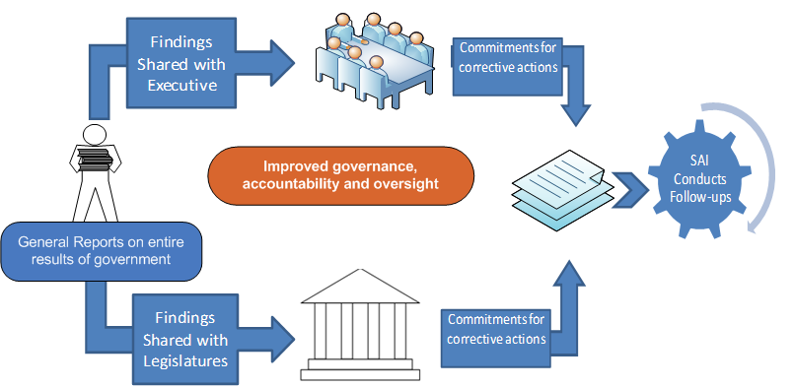
Tabling of General Reports in parliament and legislatures

Slide 19
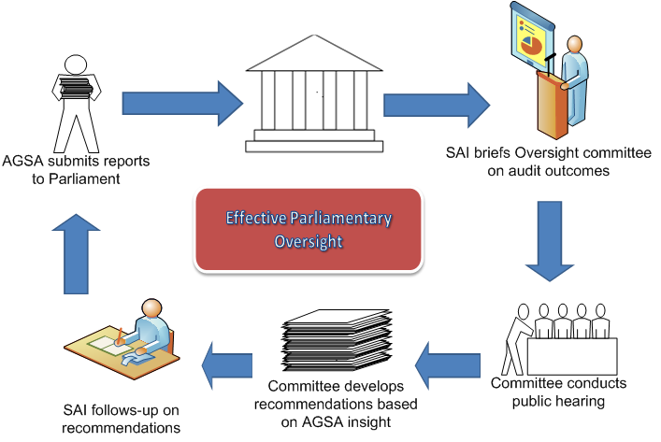
AGSA interaction with individual oversight committees

Slide 20
Thank you

