Slide 1
Chair’s Progress Report
Supreme Audit Institution of Mexico WGVBS Chair
WGVBS Meeting
April 1, 2019, Vienna, Austria
WGVBS | 1

Slide 2
WGVBS Annual Report 12th meeting – April 1-2, 2019
34 participants /
18 SAIs
China
Hungary
Jamaica
Kuwait
Mexico
South Africa
Tanzania
Portugal
USA
Austria
Cambodia
France
Greece
India
Iraq
Senegal
Spain
Turkey

Slide 3
WGVBS Annual Report
12th WGVBS meeting April 1-2, 2019 Vienna, Austria
Latest developments & progress made since the 11th meeting (Kingston, Jamaica)
New initiatives to be undertaken

Slide 4
WGVBS Annual Report Membership Status
1 new member:
*India
31 Members representing:
* 7 Regional Organizations
* 5 INTOSAI official languages

Slide 5
WGVBS Annual Report Forum of SAIs with Jurisdictional Functions
Principles of jurisdictional activities of SAIs (v. Exposure Draft).– submitted to KSC Chair foreseeing timely FIPP’s examination.
Project co-chaired by the SAIs of Chile and France
March, 2019 → Project revised by FIPP (currently on exposure period)
January 24-25, 2019 → Forum of SAIs with Jurisdictional Functions meeting to discuss the pronouncement and professionalization of SAIs.

Slide 6
WGVBS Annual Report Guideline on Effective Practices of Cooperation between SAIs, the Legislature, the Judiciary and the Executive
Task Team conformation
WGVBS Chair launched a call among members.
Interested SAIs: Ecuador, France, Iraq, Jamaica, and Turkey.
Responsible for completing annexure of the main document.
Form submitted to identify concrete examples on SAIs’ cooperation with the Legislative, Judiciary and/or Executive.

Slide 7
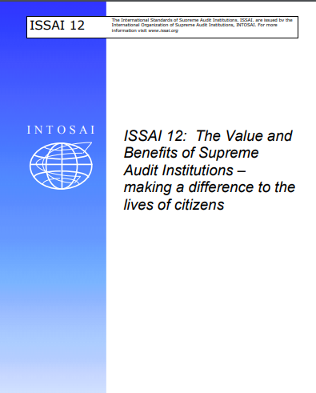
WGVBS Annual Report Implementation of ISSAI 12 Principles
Project led by the SAIs of Namibia, South Africa and Mexico
Gathering of good practices among the INTOSAI Community, regarding the ISSAI 12 implementation.
Mapping of existing INTOSAI projects related to value and benefits principles.

Slide 8
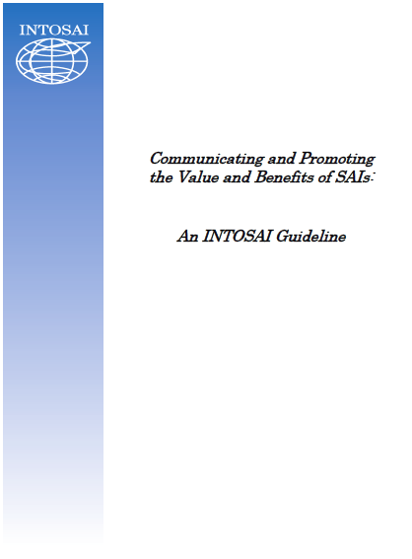
WGVBS Annual Report INTOSAI Guideline Communicating and Promoting the Value and Benefits of SAIs
SAIs of France and Iraq co-lead this Task Team’s work
Co-leaders help enriching the guideline based on comments by WGVBS members.
Guideline will be disseminated among the INTOSAI Community (3-month exposure period).

Slide 9
WGVBS Annual Report Paper on the SAIs Internal Risk Assessment and the Identification of High Risk Areas / Programs in the Public Sector
Single integrated version updated by the WG Chair, considering comments from members.
Planned to be ready for the XXIII INCOSAI
Document disseminated among the INTOSAI Community & stakeholders for comments (3-month period)

Slide 10
WGVBS Annual Report Implementation of quality control in the audit process
Task Team
Austria
Hungary
Iraq
Kuwait
Peru
Tanzania
Turkey
End of 2018 → survey launched among the INTOSAI Community.
Responses will help to generate guidance material for the ISSAI 40 principles implementation.

Slide 11
WGVBS Annual Report SAI Performance Measurement Framework
2019 SAI PMF implementation strategy
New and strongly related initiative on Strategy, Performance Measurement and Reporting (SPMR).
IDI (operational leader)
Incorporates SAI PMF and its results.

Slide 12
WGVBS Annual Report Paper on a Risk-management framework for SAIs to incorporate relevant programs related to the Sustainable Development Goals
Paper updated by the WG Chair, taking into account comments received.
Subject to a 3-month exposure period for comments from the INTOSAI Community & stakeholders
Document will be ready for the XXIII INCOSAI

Slide 13
WGVBS Annual Report FIPP activities
Latest developments!
To be presented by the PSC Chair

Slide 14
WGVBS Annual Report Main risks & challenges for SAIs by incorporating investigative powers among their functions
11th WGVBS’s meeting agreements
Brief document to trigger discussion
Potential result: Drafting a paper, as a reference for SAIs.
Goal: present paper at XXIV INCOSAI

Slide 15
WGVBS Annual Report Collaboration opportunities with the WGVBS
Sharing knowledge with stakeholders (IBP).
Potential international joint synergies to improve the audit work.

Slide 16
WGVBS Annual Report Panel discussion
External factors that hinder SAIs’ potential development

Slide 17
WGVBS Annual Report Administrative matters
Opinion on Goal 3 matters
Migration of the WGVBS website to the KSC portal
2020 & 2021 WGVBS meetings

Slide 18
WGVBS Annual Report National cases
China
Hungary
Kuwait
Portugal

Slide 19
WGVBS Annual Report KSC-SC, INTOSAI Governing Board & INCOSAI
- 72nd INTOSAI Governing Board meeting - XXIII INTOSAI Congress → September 23-29, 2019 (Russian Federation)
11th KSC-SC meeting → June 12-14, 2019 (Philippines)

