Slide 1
Agenda Item # 9
Progress Report on:
Risk Management Process in SAIs
Risk Identification Process in the Public Sector
SAI of Mexico, WGVBS Secretariat
September 6, 2017

Slide 2
Background Information
Discussion on risks identification and management
2015 WGVBS meeting, Nanjing, China
Key National Risks
Main elements SAIs should take into account
Internal Functioning Risks

Slide 3
Background Information
2015 – Nanjing, China
2016 – Arusha, Tanzania
Regarding the roundtable discussion on the importance for SAIs to identify and manage their own risks as well as those of the public sector, the SAI of Mexico will prepare a draft to expound the main elements that SAIs should take into account to identify both (1) key national risks, and (2) its own internal functioning risks. As for the former, the SAI of Mexico will work with the US GAO, and as to the latter, the coordination will be with the National Audit Office of China.
Draft versions
Risk Management Process in SAIs
Risk Identification process in the public sector

Slide 4
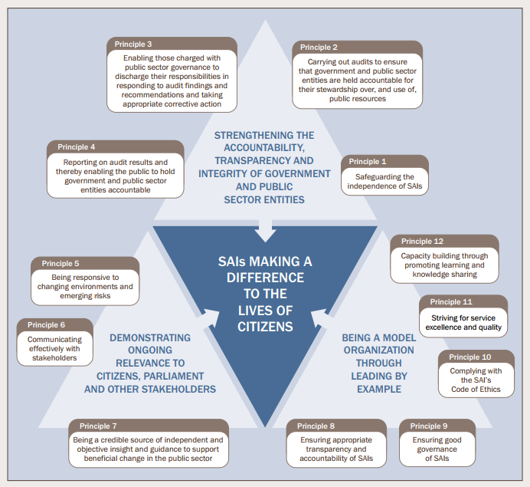
Relevance of ISSAI 12
Principle 5: “[To make a difference in the lives of citizens, SAIs must] be responsive to changing environments and emerging risks.”
SAIs need to be seen as trustworthy
SAIs must be perceived as credible, competent, independent, and accountable institutions that lead by example.
Implementing an effective risk assessment process within SAIs, including integrity risks, is necessary.
Risk self-assessment procedures contribute to reaching institutional goals and objectives

Slide 5
(1) Risk Management Process in SAIs Initial conditions to carry out a risk assessment process
Support of top management, within the SAI.
Risk identification carried out by experienced staff members of middle management positions to ensure an effective detection of threats and vulnerabilities.
Risk identification can be performed by conducting surveys and holding meetings with selected staff.
Report to the head of SAI should be prepared accordingly.
Workshops with every department so as to enhance risks detection mechanisms (advisable).
1. Setting goals
2. Risk identification
3. Risk classification
4. Risk evaluation
5. Risk prioritization
6. Control Evaluation
7. Risk response
8. Report to the Head

Slide 6
(1) Risk Management Process in SAIs Project led by SAI of China and Mexico
Introduction
I. Identification of Strategic Goals and Institutional Process
II. Risk Identification
III. Risk Classification
IV - V. Risk Evaluation and Prioritization
VI. Evaluation of Existing Controls
VII. Risk Response
VIII. Reporting to the Head

Slide 7
(2) Risk Identification Process in the Public Sector Introduction
Principle Five of ISSAI 12 highlights the value SAIs can provide by identifying the risks facing the public sector.
WGVBS could contribute with a framework for SAIs to use in identifying the areas of significant risk that governments face in their programs and operations.
cumulative results of work performed on audited entities to identify significant, recurring, and persistent problems within the federal government
SAIs are in an ideal position to identify these high risk areas through their broad audit perspective and the analytical disciplines that they routinely apply across government.
This work can result in focusing decision makers’ attention on critically important areas of government, enhancing the quality and depth of public debate, and encouraging follow up to ensure that the issues are resolved.
Definition of Public Sector Risk Areas
Factors affecting Public Sector Risks
Approaches used to identify Risk Areas
Users of Risk Information
Case Studies

Slide 8
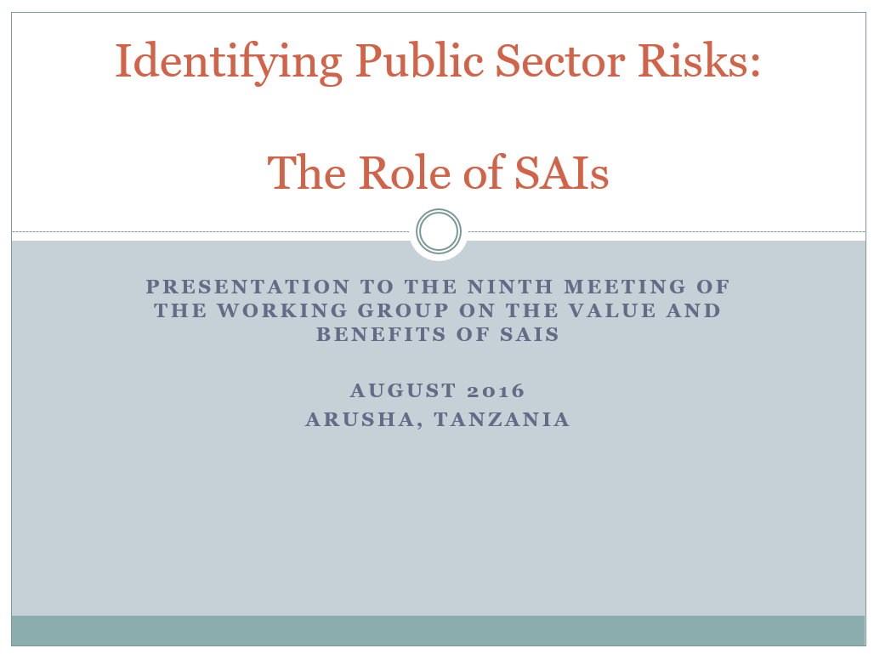
(2) Risk Identification Process in the Public Sector Project led by US GAO and SAI Mexico
Case studies demonstrate the potential contribution that the systematic identification of high risk areas across government can make to
Increasing transparency and accountability
Improving the efficiency and effectiveness of government
Increasing public understanding of the value and benefits of SAIs.

Slide 9
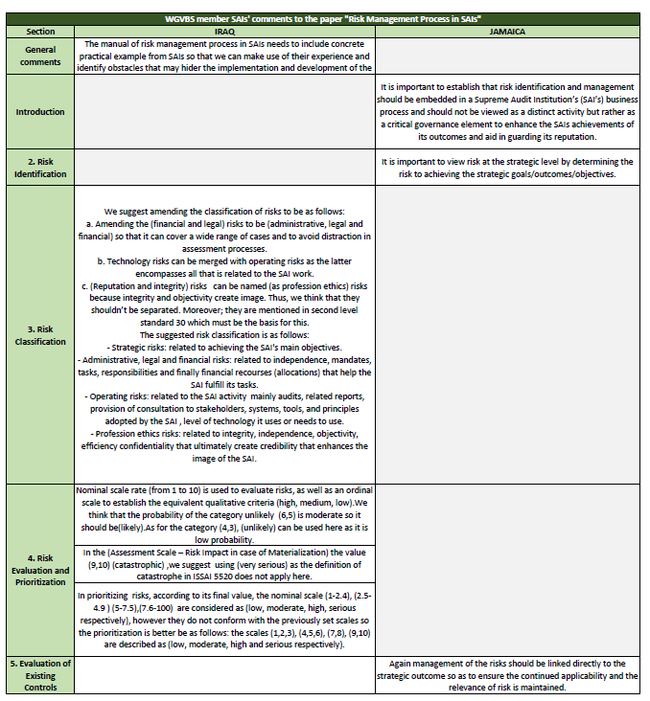
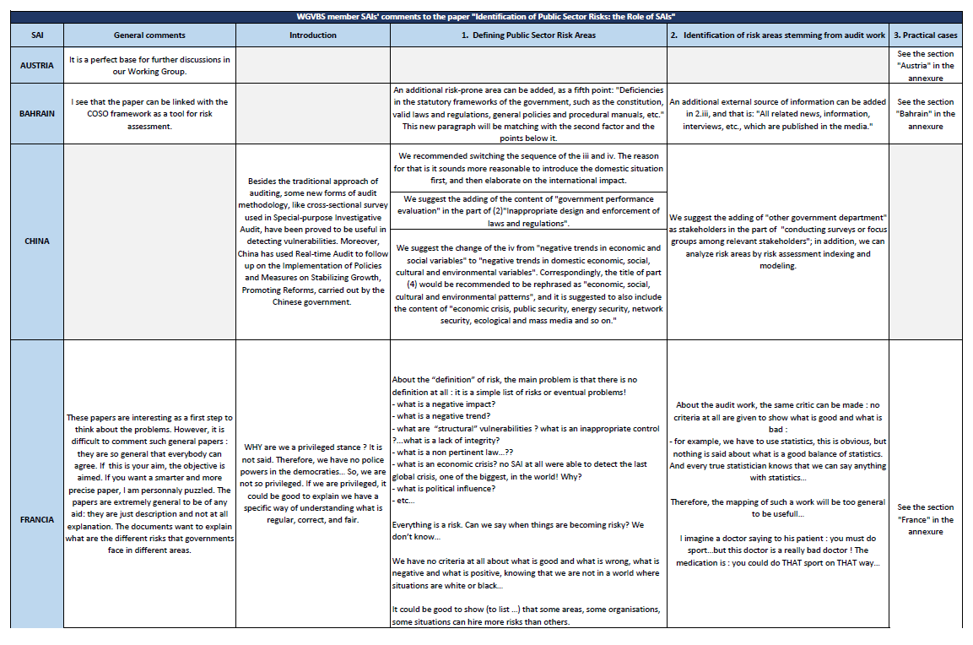
Consultation period within the WGVBS
Following the presentations of the papers regarding the Risk Identification process in the Public Sector, and Risk Management Process in Supreme Audit Institutions, the WG members agreed upon providing comments to the draft version, which will be afterwards enriched by the project coordinators.
Austria
Bahrain
Iraq
Jamaica
United Kingdom
Peru
China
France
New Zealand

Slide 10
(1) Risk Management Process in SAIs Feedback
General comments
Need to include concrete practical examples (experience and obstacles).
Introduction
Risk identification and management should be embedded in a SAI’s business process
Critical governance element to enhance the SAIs achievements of its outcomes and aid in guarding its reputation
Risk Identification
View risk at the strategic level by determining the risk to achieving the strategic goals/outcomes/objectives
Risk Classification
Feedback to amend, rename and merge risks
Comments useful to enrich the risks definitions
Risk Evaluation and Prioritization
Comments to calibrate the scale rate
Evaluation of Existing Controls
Management of the risks linked directly to the strategic outcome so as to ensure the continued applicability and the relevance of risk is maintained

Slide 11
(2) Risk Identification Process in the Public Sector Feedback
Defining Public Sector Risk Areas
New (fifth) point: “Deficiencies in the statutory frameworks of the government, such as the constitution, valid laws and regulations, general policies and procedural manuals, etc.“
Adding of the content of "government performance evaluation" in the part of (2)"Inappropriate design and enforcement of laws and regulations".
Feedback to enrich the definition of “Risk”, and to clarify criteria
Identification of Risk Areas stemming from the audit work
Suggested sources of information
The identification of cross-sector themes or issues is an important role for SAIs. SAIs are typically well placed to report on such matters, given the role of the SAI as the auditor of all public entities.
SAIs should be regularly scanning across the public sector looking for sector wide risks and issues. Such scanning should inform not only what SAIs publicly report, but also should influence the SAIs future work programme. This could rise to future work by the SAI (for example a performance audit in a risk area).
Ongoing monitoring of both high risk entities in the public sector and high cross-sectoral issues will ensure that SAIs remain focused on key public sector risks. The regular reporting of such risks will help ensure the government is able to put in place appropriate mitigations for the risks identified.
Such risk assessments can be done using judgement (qualitative assessments) or a mixture of the two.
General Comments
Base for further discussion within the WGVBS
Linkage with COSO framework as a tool for risk assessment
First step to think about the problems, and to tell the real truth about what SAIs are auditing.
Introduction
Need to go beyond the traditional approach of auditing. Some new forms of audit methodology could be referred (cross-sectional survey used in special-purpose investigative audit, real-time audit).
Clarification required to present the document as a first step towards an ambitious paper.
Audit work and discussion across audit teams can identify cross-governmental issues, as well as departmental issues.
Need to say that the SAIs seek to identify emerging risks as part of their auditing activities.

Slide 12
INTOSAI Strategic Plan 2017-2022
Crosscutting priority 4: “Creating a strategic and agile INTOSAI that is alert to and capable of responding to emerging international opportunities and risks”.
INTOSAI faces opportunities that it can seize and organizational risks that must be monitored and managed.
Enterprise Risk Management (ERM) is an essential element of good organizational governance and accountability. It is a systematic and organization-wide approach that supports an organization’s achievement of its goals and strategic objectives by identifying, assessing, evaluating, prioritizing, and managing risks to the achievement of those goals and objectives across the organization. → INTOSAI’s Supervisory Committee on Emerging Issues

Slide 13
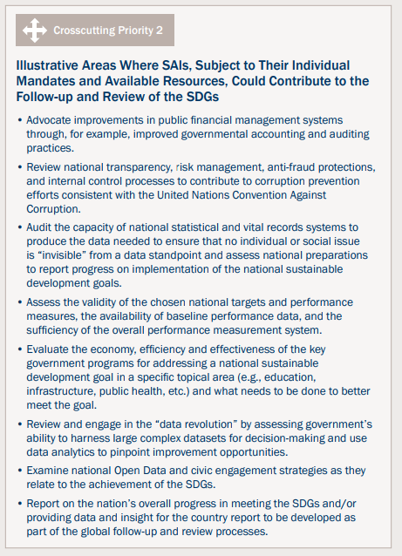
INTOSAI Strategic Plan 2017-2022
One of the illustrative areas where SAIs, subject to their individual mandates and available resources, could contribute to the follow-up and review of the Sustainable Development Goals (SDGs).
Review national transparency, risk management, anti-fraud protections, and internal control processes to contribute to corruption prevention efforts consistent with the United Nations Convention Against Corruption.

Slide 14
Way forward
Feedback from the INTOSAI Supervisory Committee on Emerging Issues*
Guidance on INTOSAI perspective regarding its perspectives on Enterprise Risk Management (ERM)
Revised papers
Comments from the WGVBS members.
WGVBS decision on next steps
Discussion to be held on September 7, 2017 (10th WGVBS meeting)
*/INTOSAI Supervisory Committee on Emerging Issues:
Co-operation with other bodies to be alert to emerging issues (global and regional implications), and their different manifestations in different parts of the world.
Focus to ensure that INTOSAI’s crosscutting priorities are being consistently and thoroughly integrated in INTOSAI’s various strategies and programs under its strategic goals.

Slide 15
Agenda Item # 9
Progress Report on:
Risk Management Process in SAIs
Risk Identification Process in the Public Sector
SAI of Mexico, WGVBS Secretariat
September 6, 2017

