Slide 1
Risk Identification Process
Mr. Benjamín Fuentes
Head of the Technical Unit at the SAI of Mexico
WGVBS Chair

Slide 2
Risk Identification Process Contents
Relevance of risk assessment
Next steps
Papers fusion agreement
Development and structure of the paper
Questions

Slide 3
Risk Identification Process Relevance of risk assessment
ISSAI 12
Principle 5
Being responsive to changing environments and emerging risks
SAIs value to citizens

Slide 4
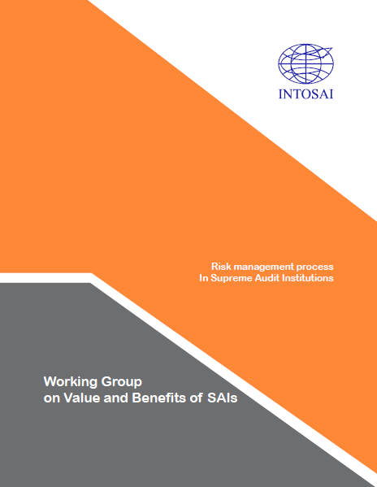
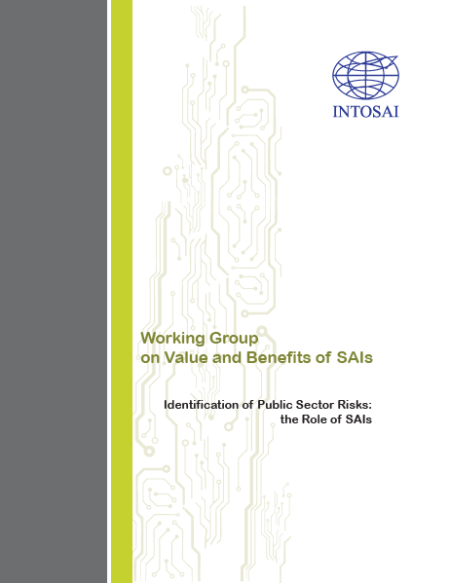
Risk Identification Process Papers fusion agreement
Risk management in SAIs
Risk identification in public sector

Slide 5
Risk Identification Process Development of the paper (non-IFPP)
Quality level # 2
(1) Comments from WGVBS & INTOSAI
(2) Comments from relevant stakeholders
WGVBS Chair fused both papers
Round for comments.
Deadline: August 15, 2018
Comments from:
Austria
Ecuador
Iraq
Kuwait
Pakistan
Peru
Portugal
Russian Federation

Slide 6
Risk Identification Process Structure of the paper
(1)
SAIs Internal Risk Assessment
(2) Identification of high-risk areas / programs in public sector
Practical cases

Slide 7
Risk Identification Process Structure of the paper
(1) SAIs Internal Risk Assessment
Initial conditions to carry out a risk assessment process
Risk evaluation and prioritization
Evaluation of existing controls
Risk response
Reporting and monitoring
Risk management general process
Identification of strategic goals and institutional processes
Risk identification
Risk classification
(2) Identification of high-risk areas / programs in public sector
Defining public sector risk areas
Identification of risk areas stemming from audit work

Slide 8
Risk Identification Process Structure of the paper
Austria
Iraq
Mexico
Peru
United States of America
Bahrain
Practical cases

Slide 9
Risk Identification Process Next steps
Document to be updated
Round for comments among INTOSAI and stakeholders
Document to be presented at the 2019 INCOSAI

Slide 10
Risk Identification Process

