Slide 1
Guideline of Cooperation Between SAIs and Government Branches

Slide 2
Guideline of Cooperation Between SAIs and Government Branches
2017

Slide 3
Guideline of Cooperation Between SAIs and Government Branches
September to October 2017
November to December 2017 – Draft Annexure to Guideline
Notes:
September to October 2017
The results of the Survey will be analyzed to determine what information we can use to enhance the guideline as it is with information that was not there before. Based on the responses that we have (105) we have the opportunity through technology to greater stratify the SAI community into the varying models.
Additionally, the main purpose of the questionnaire was to obtain the good practices of the various SAIs. We are now in this position. The information will be assessed and efforts made to authenticate the responses with tangible evidence.

Slide 4
Guideline of Cooperation Between SAIs and Government Branches
January 2018
Consultations among Working Group Member
February 2018
Incorporate comments
March 2018 to May 2018
Dissemination of the Guideline with Annexure to the INTOSAI Community for comments

Slide 5
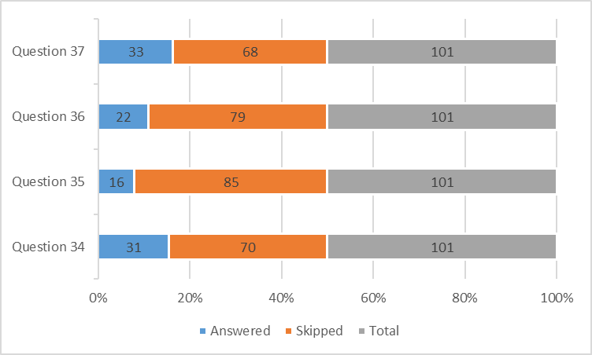
Guideline of Cooperation Between SAIs and Government Branches
Graph showing total number of respondents to questionnaire
Graph showing the proportion of questions answered based on SAI type

Slide 6
Guideline of Cooperation Between SAIs and Government Branches
Sample size small
Ambiguity of responses
Questions not focused
No Annexure
No Annexure
No Annexure

Slide 7
Guideline of Cooperation Between SAIs and Government Branches Draft form
Draft form
Purpose
Identify concrete examples on SAIs’ cooperation with the Legislative, Judiciary and/or Executive
Focused on concrete actions
1) positive impact either in SAI’s work
2) Relationship between the institutions and the government branches

Slide 8
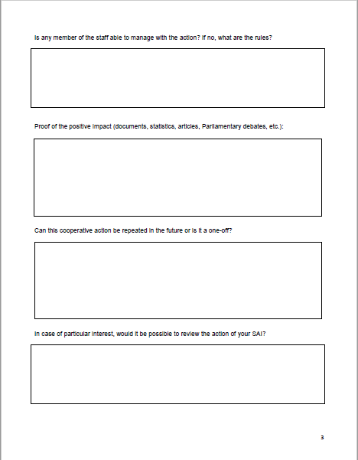
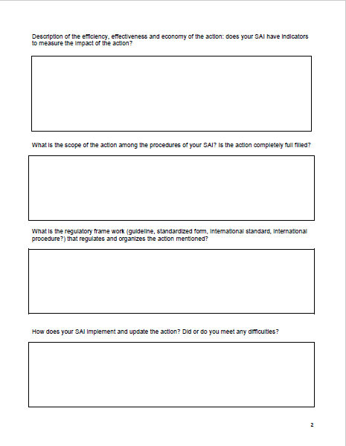
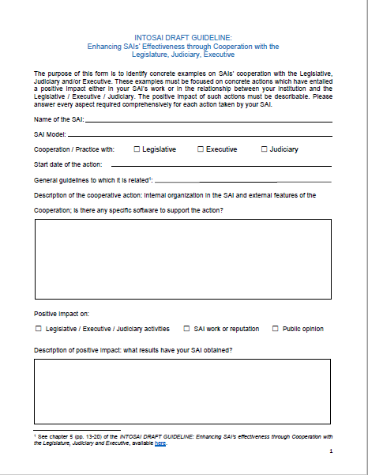
Guideline of Cooperation Between SAIs and Government Branches
Draft form
Description of cooperative action
Impact and results
Indicators to measure impact
Staff engagement
Scope and current status
Regulatory framework
Ways of implementation and update
Impact evidence
Replication
Review

Slide 9
Guideline of Cooperation Between SAIs and Government Branches
Next steps
Proposal
Distribution among the WGVBS members
Deadline to complete the form: October 31st, 2018

