Slide 1
Guideline of Cooperation Between SAIs and Government Branches
Project Group 4
Status Report on the development of the Annexure

Slide 2
Guideline of Cooperation Between SAIs and Government Branches - 2017 Survey
Small sample sizes
Ambiguity of responses
Questions not focused

Slide 3
Guideline of Cooperation Between SAIs and Government Branches
November 20 2018
Call for new members to task team
Form to capture information disseminated
December 13, 2018
Formal announcement of new task team
Ecuador, France, Jamaica, Iraq & Turkey
March 18, 2019
Deadline for the submission of form

Slide 4
Guideline of Cooperation Between SAIs and Government Branches
Purpose
Identify concrete examples on SAIs’ cooperation with the Legislative, Judiciary and/or Executive
Focused on concrete actions
1) positive impact either in SAI’s work
2) Relationship between the institutions and the government branches

Slide 5
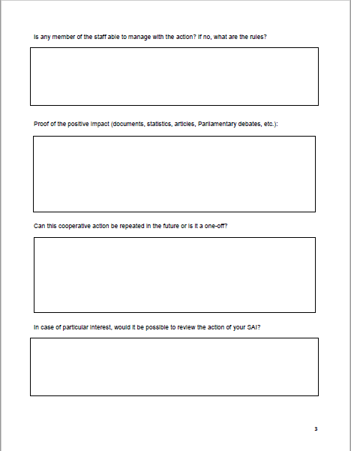
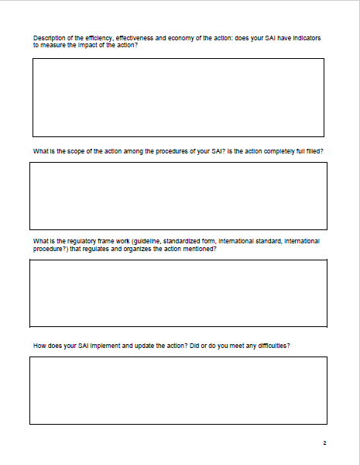
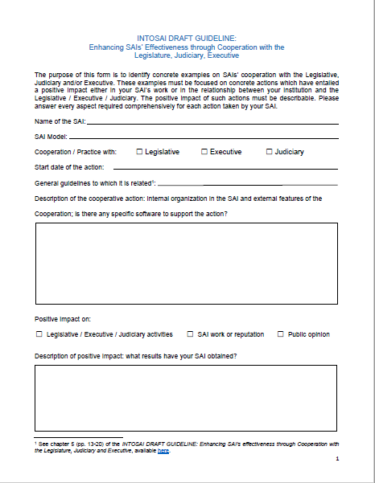
Guideline of Cooperation Between SAIs and Government Branches
New form
Description of cooperative action
Impact and results
Indicators to measure impact
Staff engagement
Scope and current status
Regulatory framework
Ways of implementation and update
Impact evidence
Replication
Review

Slide 6
Guideline of Cooperation Between SAIs and Government Branches -Responses received

Slide 7
Next Steps
1st QTR -2019
Data Capture forms received
2nd - QTR
Data analysis
3rd -QTR
4th - QTR
Updated guideline shared with INTOSAI community
Develop Annexure
WGVBS members’ comments on Annexure
Coordination with FIPP & KSC to define process to be followed for the Guideline and Annexure to be approved by INTOSAI
XXIII INCOSAI, 2019
September 23-29, 2019.

