Slide 1

SAI PMF Progress Update WGVBS Meeting
Vienna, Austria
01 April 2019
Notes:
This presentation will provide information about progress as of August 2017 towards achievement of the SAI PMF strategy 2017-19 and 2017 SAI PMF annual plan.
Refer also to the 2017 progress report that is available at the CBC website as part of the CBC and IDC meetings document package.

Slide 2

Progress against SAI PMF strategic outcomes
SAI PMF Strategic Outcome | Related Outcome Indicator | Milestone 2019 | Realization up to March 2019 | Outlook end 2019
Outcome 1: Establish SAI PMF as a widely recognized tool in the INTOSAI community | 1. Cumulative number of SAIs with a SAI performance report | 65 | 56 | 70
Outcome 2: High-quality, credible and relevant assessments | 2. % of conducted assessments finalized that includes an IR statement | 55% | 69% | 70%
 | 3. % of conducted assessments that are reported as having been used as basis for SAI strategic planning and/or capacity building projects | 90% | 95% | 95%
Notes:
Progress towards fulfilment of the various activities foreseen in the SAI PMF Implementation Strategy under the outlined core functions has been significant, despite understaffing of the SAI PMF unit in the establishment phase.
On the operational side, the SAI PMF unit has been heavily involved in various support and coordination activities. E.g.:
A new training program structure with five modules has been developed, to ensure adequate basic training and continued development of SAI PMF expertise.
Most of the training and guidance materials have been updated and brought in line with the SAI PMF endorsement version, and additional work papers have been developed to support assessors.
Provided three basic training courses on the SAI PMF, one of these as part of a PASAI facilitation program.
Arranged, overlooked and provided guidance to the review of eight assessments, - in addition to conducting one review in whole internally
Commenced its work to develop regional implementation plans in cooperation with INTOSAI regional Secretariats and other relevant committees. The process needed for developing regional implementation plans has been a bit more comprehensive than anticipated, this has delayed this work slightly. However, IDI has initiated discussions with the majority of INTOSAI regions.
All outcome indicators targets set in SAI PMF strategy 2017-19 are either reached or will be reached by end of 2017
Indicator 1: Cumulative number of SAIs with a SAI performance report based on SAI PMF
Milestone 2017: 40
Realization August 2017: 34 (expected to be passing 40 by end of 2017, due to reports currently being in for review and expectations to receive more)
Indicator 2: Assessments finalized last three years including Independent Review statement
Milestone 2017: 53%
Realization August 2017: 61%
Indicator 3: Assessments finalized last three years used as basis for strategic or capacity building planning
No targets for 2017/18
15 out of 17 (88%) SAI PMF assessments for which data is available

Slide 3
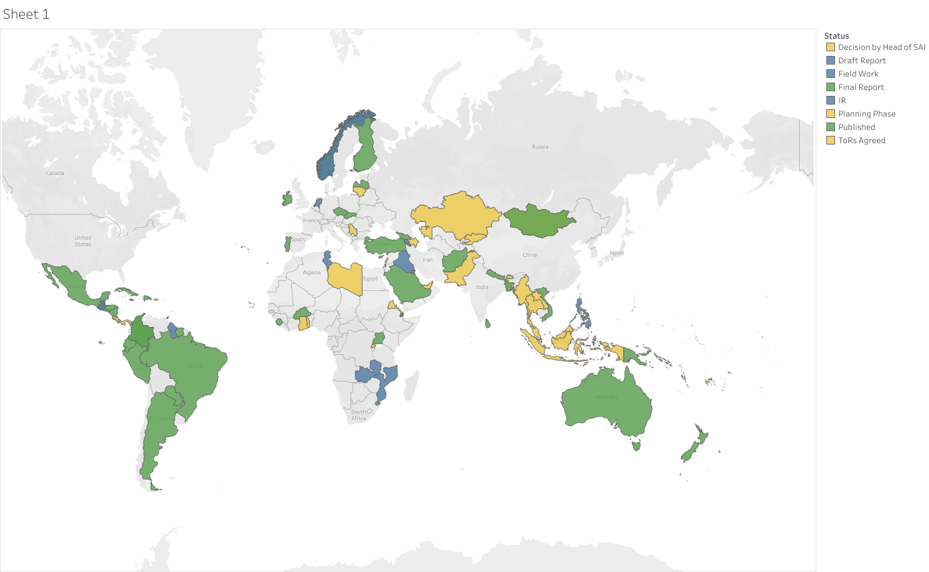
Green – final or published report, Blue – draft report, field work or in IR, yellow – start up phase

Slide 4
Major recent developments
First advance course in Peru
First independent review workshop
Focus on repeat assessments incl. guidance
SAI PMF facilitation programs in ASOSAI and as part of SPMR
Work on updating SAI PMF strategy

Slide 5

Strategy, Performance Measurement and Reporting program (SPMR)
The program’s global objective is to have strategically managed SAIs and INTOSAI regions leading to higher performance.
Strategic Management handbook
Evidence based assessment of the SAI current situation (SAI PMF)
Monitoring and Reporting on Performance
Development of SAI Strategic plan, operational plan and performance measurement system
Repeated assessment of performance (SAI PMF)
5 year global programme
Funded by Swiss Development Cooperation
Combination of workshops, remote and in-country support
SPMR Pilots in PASAI and CAROSAI (17 SAIs)
Ongoing in ASOSAI, EUROSAI and AFROSAI-E (20 SAIs)
Planned to start in ARABOSAI, CREFIAF and OLACEFS later this year

Slide 6
SAI PMF Strategy Update for 2020-2022
Revised strategy emphasizes
Ensuring quality of assessments
Crtical mass of SAI PMF experts
Stronger
link to use of SAI PMF results
Encouraging publication of results
Awareness-raising on costs and benefits
Anticipation
of revisions to the framework

