Slide 1
The International Budget Partnership and Collaboration Opportunities with the WGVBS
WGVBS Meeting
April 1-2, 2019

Slide 2
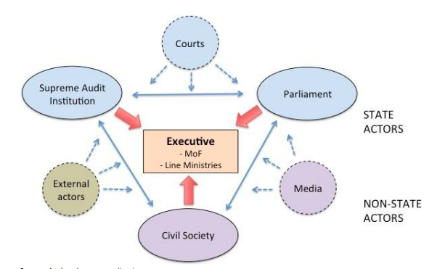
Accountability Ecosystem

Slide 3
How SAIs can engage with civil society
Invite civil society and citizens to report areas that they should cover in their audits
Directly involve civil society and citizens in their audits
Help civil society understand their technical audit findings and thereby enable civil society to demand that governments take remedial actions in line with audit recommendations

Slide 4
Advancing Audit Accountability
IBP collaborating with SAIs, civil society and international partners, such as IDI, GIZ and the UN DESA, to strengthen audit impact
In diverse countries, SAIs and civil society are acting collectively to enhance government responsiveness on audits that have been ignored.
We intend to document interventions to address audit recommendations, and lessons for enhancing accountability

Slide 5
Strategic Partnership of IDI and IBP
Promote learning and produce a focused report drawing on the Open Budget Survey and IDI’s Global SAI Stocktaking Report.
Support the review of country strategies for stakeholder engagement
Share strategic insights and guidance at the country and international level
Advocate for independence and an enabling environment for oversight institutions.

Slide 6

Claire Schouten
International Budget Partnership cschouten@internationalbudget.org

