Slide 1

The Court Registry
Certification Process ISO 9001-v2015
July 2018

Slide 2

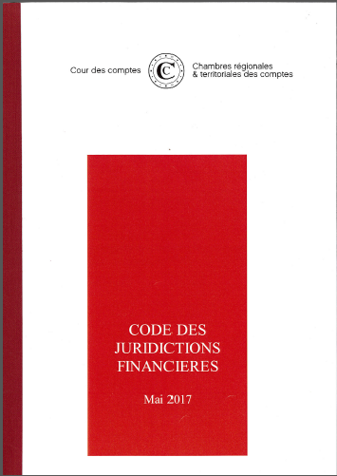
THE ISO 9001-V2015 QUALIFICATION FOR THE COURT REGISTRY’S DUTIES
A procedure on the fundamental principles that govern the institution’s procedures.
Credibility and exemplary
manner in which the procedures are carried out
Collegiality
Review and Response

Slide 3
The court registry: a central position in the financial courts
General
Rapporteur
Secretary General
Registries of
The Court’s Chambers
THE COUR DES COMPTES’ REGISTRY
THE FIRST PRESIDENT’S REGISTRY
Supporting jobs
Functional Authority
(Public reports,
Parliamentary reports)
RTCA Registries
Administrative Commiunications Centre
Management of accounts and control archives
Litigation Registry
Duty to assist the registries
Project management division for the Registries’ Information Systems
Public Reports
Parliamentary Reports
“Référés” (short letter report)
Final observations on public companies
Procedures subject to the First President’s signature
Management of accounts
Accounting standards
Collection of Auditors’ reports
Management of archives and stores
Litigation procedures
Public Hearings’ Registry
Follow-up of procedures
Notifications
Network of Financial Courts’ Registries
Oath taking for Registry staff, control assistants and experts
Registry Information System Training
Project management
Assisting project management
User Support
Traditional duties of the Registry
(implementation of procedures)
Duty to assist
and support

Slide 4


the certification of the court registry:
A managerial and collective project
The observation made at the end of 2015
Registry tasks all require different areas of expertise but the staff rarely help each other
The relationship with the Court’s internal partners is not clearly defined
Creation of a referral of processes and partnership relations
Quality Management System support

Slide 5

The quality management system implemented meets the Conrcrete objectives
Secure the processes and procedures implemented by the service
Standardise the Registry’s practices
Manage activities and risks
Improve the Registry’s performance: delays and quality of procedures or implemented actions
Measure the performanec of the activity over time and evaluate the visible progress
Reinforce the development of employees’ abilities, and assemble teams for a common, stimulating project

Slide 6
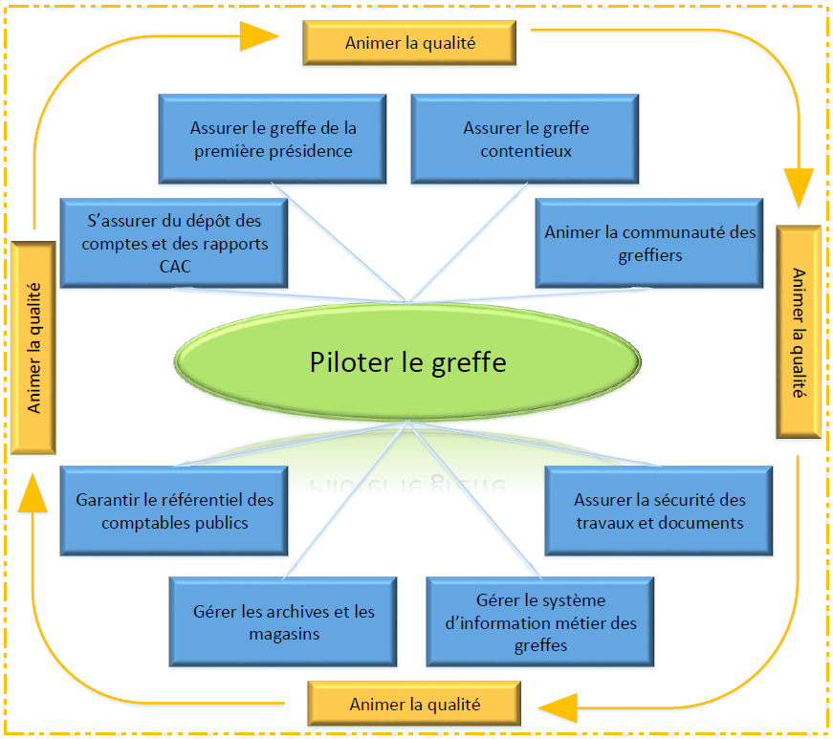
1st stage: Create an exhaustive Business plan for the Court Registry…
MANAGING THE REGISTRY
MANAGING COURT CLERKS COMMUNITY
MANAGING THE REGISTRY OF THE FIRST PRESIDENCY
MANAGING THE REGISTRY OF LITIGATION CASES
ENSURING PUBLIC ACCOUNTANTS STANDARDS
SUPERVISING THE DEPOSIT OF ACCOUNTS AND REPORTS BY AUDITORS
MANAGING THE ARCHIVES AND STORES
MANAGING THE PROFESSION INFORMATION SYSTEM OF THE REGISTRIES
ENSURING THE SAFETY OF WORK AND DOCUMENTS

Slide 7
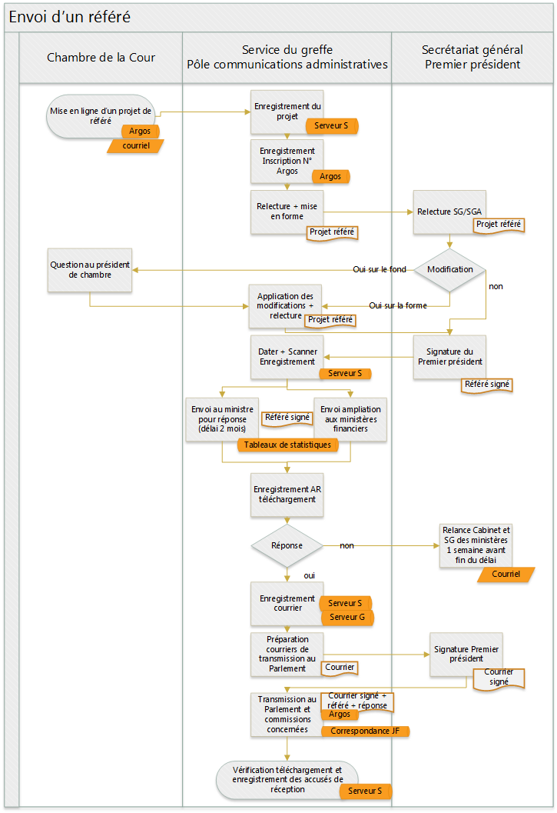
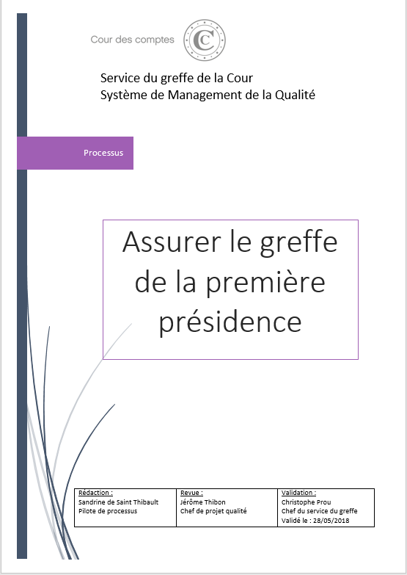
1st stage: … and describe the procedures through flowcharts and operating procedures
Each business process has its own procedures
Procedure: the sending of a référé
Explained through flowcharts on actions by the actor of the procedures

Slide 8

2nd stage: Create, through agreements, a shared understanding of the issues and objectives with the institution’s internal partners
Public Prosecutor’s Office
Chambers of the Court
Chambres régionales et territoriales des comptes
Public Report and Programmes of the Registry
Procédures partagées
Moyens humains
et techniques
Human Resources Department
Information Systems Department
Logistics Department
Business Support Centre

Slide 9


A complex system that needs to make a Customer listening service adapted to the Registry environment
A systematic evaluation of training as part of its duty to support business and information systems users
An annual review of the partnership agreements to evaluate their implementation and analyse activity and performance indicators, if applicable
An annual investigation of the Financial Court Registry’s employee satisfaction rates is carried out in order to gauge their degree of satisfaction on support tasks that are part of their work

Slide 10

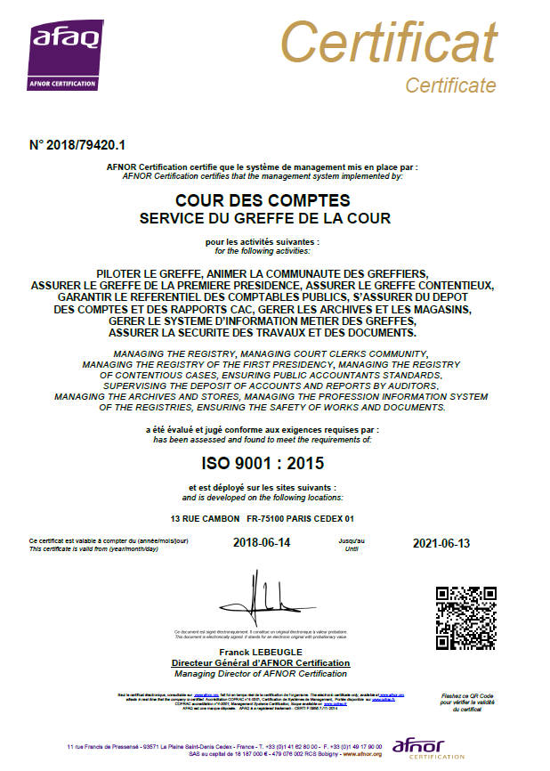

A renowned quality management system conforms to the standard requirements of the iso 9001-v2015
Certificated by AFNOR 13 JUNE 2018
The orientation of « clients » concerning the process
The leadership
The involvement of Registry employees
The process approach
The principal of continuous improvement
The implementation of a performance-measuring system
The management of the relationship with the Registry partners concerned

Slide 11
A quality management system based on the principle of continous improvement
Act
Plan
A
P
Continuous Improvement
Correctional Actions
Non-conformity
Context and risks
The Registry’s Performance
Contract
Qualitative Objectives
Act
Plan
Leadership
C
D
Control
Implementation
Control
Do
Reviewing the direction
Internal Audit
Measuring the Activity
Evaluating Performances
Procedures
Actions taken for the performance contract
Network of clerks
Accompanying the SI Users

Slide 12

A project conducted according to the methodology of 7S recommended by the International Organization for Standardization (ISO)
Planning
Implementation of the SMQ
Certification Audit
Follow-up
Conception of the SMQ
Mock Audit
Initialisation
In a strict planning : 23 months from start to finish of the project and certification
15/09/2016
15/09/2016 … au … 01/08/2017
04/2018
05/2018
13/06/2018
Official launch
of the project
Conception of the SMQ
Training employees
Mapping processes
Formalisating procedures
MockAudit
Internal Audit
Certification
By making use of
Internal resources (managed by a Project Quality manager)
Reduced external support (11 staff per day)

