Slide 1
Agenda Item #2
CHAIR´S REPORT
September 6, 2017

Slide 2
WGVBS Annual Report 10th meeting September 6-8, 2017
30 Participants / 15 SAIs & The World Bank
Cameroon
China
France
Hungary
Jamaica
Kuwait
Mexico
Namibia
Pakistan
Peru
Russia
South Africa
Tanzania
USA
Indonesia
World Bank

Slide 3
WGVBS Annual Report
10th WGVBS meeting September 6-8, 2017 Mexico City
Latest developments and progress made since the 9th meeting held in Arusha, Tanzania
New initiatives to be undertaken

Slide 4
WGVBS Membership Status
Incoming members:
*Hungary
*Kuwait
*Moldova
Outgoing members:
*Bahrain
*Germany
22 members
Members representing:
7 Regional Organizations
5 INTOSAI official languages

Slide 5
WGVBS’ Mandate
STRATEGIES
TOOLS
MECHANISMS
Communicating and promoting the value and benefits of SAIs
The WGVBS develops

Slide 6
WGVBS’ Mandate
WGVBS works on awareness raising
Impact and value of supreme auditing
EFFICIENCY
STAKEHOLDERS
TRUST
Make a difference in the lives of citizens
EFFECTIVENESS

Slide 7
WGVBS’ Projects
The Forum of SAIs with Jurisdictional Functions
Project co-chaired by the SAIs of Chile and France
Space of reflection, collaboration and exchange of good practices
Among SAIs with this type of organizational model

Slide 8
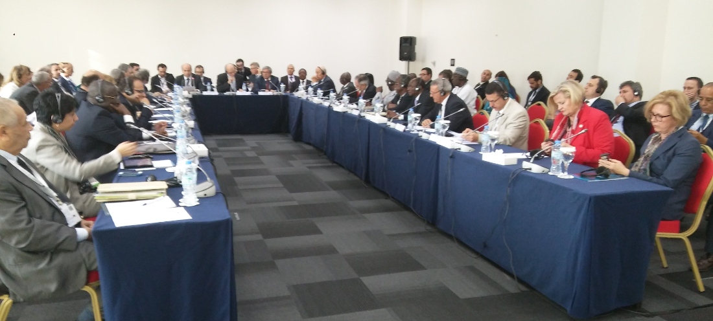
WGVBS’ Projects Forum of SAIs with Jurisdictional Functions
THE PARIS DECLARATION
Ratified by the Forum and other stakeholders during a side event of the INCOSAI (Abu Dhabi, December 2016)
Lists the value of SAIs with jurisdictional functions
Promotes the value and benefits of the jurisdictional SAIs
INDEPENDENT
CREDIBLE
EFFECTIVE

Slide 9
WGVBS’ Projects Forum of SAIs with Jurisdictional Functions
Subgroup on jurisdictional activities standardization
Co-chaired by SAIs of Chile and France, created under the umbrella of the WGVBS
Guide on the value and benefits of SAIs with jurisdictional functions
Tools used by jurisdictional SAIs to effectively fight against fraud and corruption
Project proposal presented before the FIPP

Slide 10
WGVBS’ Projects Guideline on SAIs Cooperation with the Branches of Government
SAI of Jamaica
“Guideline on Effective Practices of Cooperation between SAIs, the Legislature, the Judicial, and the Executive”
During the 2016 meeting (Arusha, Tanzania), the KSC-SC approved the revised guideline without its annexure.

Slide 11
WGVBS’ Projects Guideline on SAIs Cooperation with the Branches of Government
Enrich its drafting and examples included
Develop and apply an online survey to the INTOSAI Community
Provide comments and good practices on the cooperation strategies with the 3 government branches
WGVBS members agreed to:
Keen participation of the INTOSAI community
After the 10th WGVBS meeting, the revised version of the guideline will be presented to the KSC Chair

Slide 12
WGVBS’ Projects Implementation of ISSAI 12 Principles
Task Team members:
* Namibia
* South Africa
* Mexico
Identification, through a survey, the most challenging principles to be implemented:
3, 6, 7, 9 & 11
Mechanisms to get SAIs’ strategies and actions to implement those principles:
* Videoconferences
* Survey
WGVBS could provide the INTOSAI community with guidance to fully implement ISSAI 12 and help define the Working Group’s activities.

Slide 13
WGVBS’ Projects Papers of Risk Management
Risk Identification Process in the Public Sector
Risk Management Process in SAIs
U.S. GAO & the WGVBS Chair
CNAO & the WGVBS Chair
Papers to be updated and shared to the KSC Chair.

Slide 14
WGVBS’ Projects Task Force on Audits Quality Control (Highlights)
Diversity of institutional arrangements on quality
Importance of the tone of the top
Reference to SAI PMF
Relevance of institutional principles guiding the quality management
Discussions at 2016 WGVBS

Slide 15
WGVBS’ Projects Task Force on Audits Quality Control (Highlights)
Discussions in Arusha
Paper on Audits Quality Control (beyond ISSAI 40)
Level of independence, mandate and position within the Institution
Guiding principles of the audit quality assurance unit

Slide 16
WGVBS’ Projects Task Force on Audits Quality Control (Highlights)
Task Team
Austria, China, Iraq, Pakistan, Peru, and the USA
Work plan
Presented to the KSC Chair

Slide 17
WGVBS’ Projects SAIs Performance Measurement Framework
Endorsed by the XXII INCOSAI
Goal 3 → Goal 2
WGVBS Chair’s permanent communication with IDI
IDI as operational leader
Looks after the operationalization of the Framework strategy 2017-2019 & adequate performance measurement system
Unit

Slide 18
WGVBS’ Projects Open Government Data
Included into the WGVBS’ Work Plan
Impact on fight against corruption and money laundering, and on promotion of integrity in the public sector
(Topic) Developed by the OECD
Opportunity for SAIs to create economic value, to raise awareness of open data strategies and to be aware of potential risks and opportunities

Slide 19
WGVBS’ Projects Open Government Data
Open Government Data at WGVBS agenda
Linked to transparency, better government services, and improvement of the lives of citizens
WGVBS Chair’s communication with OECD

Slide 20
WGVBS’ Projects SAIs role in the implementation of the UN 2030 Agenda
SAI of Mexico
Paper on a risk-management framework
SAIs could incorporate programs related to SDGs in their annual audit plans

Slide 21
WGVBS’ Projects INTOSAI Tools
Communication & promotion of importance of INTOSAI tools
SAIs’ Information Database
Self-Assessment of Integrity (IntoSAINT)
KSC-IDI Community Portal
INTOSAI Online Glossary
SAIs Capacity Development Database
Experts Database

Slide 22
WGVBS’ Projects INTOSAI Tools (Relevance)
Awareness-raising tools
Impact on INTOSAI’s perception
WGVBS → Guidance material to strengthen design, implementation, dissemination & sustainability of any INTOSAI tool.

Slide 23
WGVBS’ Projects Impact of SAIs’ Work
SAIs must…
Lead by example (ISSAI 20)
Demonstrate accuracy of their auditing work
Act with neutrality and impartiality

Slide 24
WGVBS’ Projects Impact of SAIs’ Work
SAIs present national cases (good practices and experiences)
Promotion of value and benefits of supreme auditing
CHINA
INDONESIA
KUWAIT
FRANCE
SOUTH AFRICA
UNITED STATES OF AMERICA
HUNGARY

Slide 25
WGVBS’ Projects Report at the 70th INTOSAI Governing Board
.
IDEAS
EXPERIENCES
BASIS OF OUR REPORT TO BE TABLED BY:
SAI of India, KSC Chair November 6-7, 2017 Graz, Austria

Slide 26
Agenda Item #2
CHAIR´S REPORT
September 6, 2017

