Slide 1
Auditing SDGs Programs
Supreme Audit Institution of Mexico
Mr. Francisco Parral
2019 WGVBS Meeting
Vienna, Austria
WGVBS | 1

Slide 2
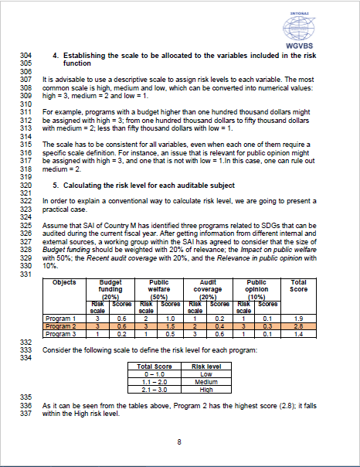
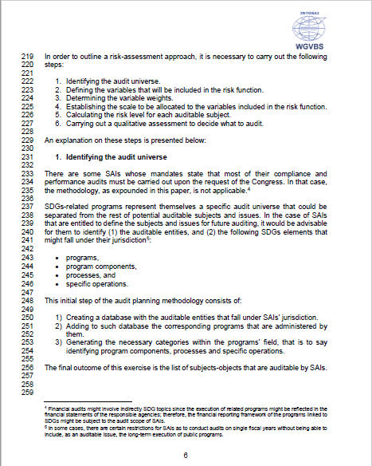
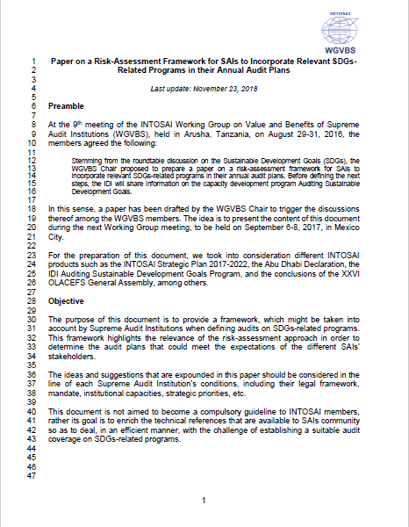
Auditing SDGs Programs Background information
SDGs
Origins: Proposed at 2016 WGVBS meeting, Arusha, Tanzania.
Purpose: Provide a framework to include SDGs-related program into SAI’s annual programming

Slide 3
Auditing SDGs Programs Latest developments
Nov 2018 - Feb 2019
WGVBS members provided feedback to the paper
Chair updated the paper taking into account feedback
Exposure version among INTOSAI Community and stakeholders for feedback
Late 2018
Early 2018

Slide 4
Auditing SDGs Programs Stakeholders
1. High Commissioner for the 2030 Agenda in Spain.
2. Expert Group of the Abu Dhabi Declaration.
3. Association des Institutions Supérieures de Contrôle Ayant en Commun l'usage du français (AISCCUF).
4. Crue Universidades Españolas (CRUE).
5. Food and Agriculture Organization of the United Nations (FAO).
6. Deutsche Gesellschaft für Internationale Zusammenarbeit (GIZ).
7. Inter-American Development Bank (GIZ).
8. International Budget Partnership (IBP).
9. INTOSAI Development Initiative (IDI).
10. Institute of Internal Auditors (IIA).
11. International Monetary Fund (IMF).
12. Organisation for Economic Co-operation and Development (OECD).

Slide 5
Auditing SDGs Programs Stakeholders
13. Organização das Instituições Supremas de Controle da Comunidade dos Países de Língua Portuguesa (OISC/CPLP).
14. Pacto Mundial.
15. Partnering Initiative.
16. Spain’s Ambassador in special mission for the 2030 Agenda.
17. Court of Audit of the West African Economic and Monetary Union (UEMOA).
18. United Nations Department of Economic and Social Affairs (UNDESA).
19. United Nations development Program (UNDP).
20. United Nations Environment Program (UNEP).
21. United Nations Institute for Training and Research (UNITAR).
22. United Nations Sustainable Development Solutions Network.
23. USAID.
24. World Bank.

Slide 6
Auditing SDGs Programs Feedback received
Algeria
Azerbaijan
UEMOA
UNDESA
World Bank
Bahrain
Bulgaria
Colombia
Costa Rica
Egypt
Estonia
Georgia
Honduras
Latvia
Lithuania
Palestine
Peru
Portugal
South Africa
Spain
Sweden
Thailand
Uganda
Institute of Internal Auditors
20
SAIs
4
stakeholders

Slide 7
Auditing SDGs Programs Next steps
Chair will update the paper taking into account feedback
Paper will be translated into 5 INTOSAI official languages
Approval by the 2019 INCOSAI, Moscow

Slide 8
Auditing SDGs Programs Next steps → Translation of the paper
Language
Arabic
Spanish
Supporting SAI
Kuwait
Pending
English
French
German
Pending
Pending
Mexico
Just wording review

