Slide 1
Administrative Matters
Supreme Audit Institution of Mexico
Mr. Francisco Parral
2019 WGVBS Meeting
Vienna, Austria
WGVBS | 1

Slide 2
Administrative Matters Contents
KSC matters
Transition of WGVBS website to KSC website
2020 and 2021 WGVBS meetings

Slide 3
Administrative Matters KSC matters - Background
KSC Chair raised a series of questions on KSC matters to all Goal 3 WGs
Mid 2018
WGVBS Chair asked the WG members about these questions
End 2018
WGVBS Chair prepared a unified response as a group for KSC based on responses received
Early 2019

Slide 4
Administrative Matters KSC matters
KSC question | WGVBS position
1) Inputs on the criteria specified by PSC on the selection of projects for the next SDP? | Minor changes suggested. Inclusion of a new criterion: the project must have clear objectives (general and strategic).
2) Intention to evaluate the impact of pronouncements developed by the WGVBS? | Yes. The impact can be evaluated through surveys.
3) Has the WGVBS identified external stakeholders for quality assurance level 1 and 2? | Yes. Such stakeholders were listed accordingly and those pending projects were specified.

Slide 5
Administrative Matters KSC matters
KSC question | WGVBS position
4) Considerations of quality assurance processes to evaluate such products? | Policies, procedures, and measurement indicators should be set by the FIPP with the aim to assess documents’ quality.
5) WGVBS Chair‘s role in the evaluation process? | WGVBS Chair will review the alignment of the documents to criteria set by FIPP, and intervene in all necessary procedures to accomplish such conditions.
6) How to deal with cases where quality assurance level has not been met? Should such exceptions be included in the QA statement? | In such cases, these should be notified to the working group, stating the weaknesses of the document and giving some recommendations on what such document needs in order to obtain the quality certification.

Slide 6
Administrative Matters KSC matters
KSC question | WGVBS position
7) Suggestions on the naming of conventions of non-IFPP documents to avoid confusion from being construed as IFPP Pronouncements? | Non-IFPP documents should avoid the terms standard, principle, guide and guideline in their naming. Alternative concept to name non-IFPP documents: paper.
8) Challenges and suggestions for the KSC Chair regarding the new desired approach with the INTOSAI Regional Organizations? | Suggestion: KSC Chair should work closely with the regional organizations’ General Secretariats to identify the bodies that accomplish similar goals to the ones overseen by the KSC. Challenge: languages differ, and they should be taken into consideration when drafting documents.

Slide 7
Administrative Matters KSC matters
KSC question | WGVBS position
9) Suggestion on how to treat the INTOSAI GOVs in the new IFPP? | INTOSAI GOVs should become GUIDs or non-IFPP documents, as decided by the FIPP.
10) Opinion on FIPP recommendations regarding the withdrawal of ISSAI 5220, ISSAI 5540 and INTOSAI GOV 9250? | They should be withdrawn as long as their substantial contents are considered in the next SDP.
11) Suggestions on the concrete use of Goal 3 allocation for 2017 and 2018? | KSC Chair should make an inventory of all projects currently being developed by the Goal 3 WGs. Based on this, funds should be allocated to those projects which are expected to have the broadest impact.

Slide 8
Administrative Matters KSC matters
KSC question | WGVBS position
12) Does the WGVBS need an allocation of certain amount of Goal 3 financial resources? | Yes, it would be convenient for international seminars and workshops regarding tools / initiatives / mechanisms that encourage the value and benefits of SAIs.
13) Should global training facilities be created? | New global training facilities should not be created since there are many SAIs in each region that have already these training centers with the necessary infrastructure, resources and experience.
14) Suggestions on topics for the crosscutting research projects for the next work plan? | • International experiences in SDGs implementation and the procedures taken by SAIs to audit such implementation. • Close cross-border cooperation between SAIs regarding transnational corruption and money laundering.

Slide 9
Administrative Matters WGVBS website transition
www.wgvbs.org.mx
March 2019 → WGVBS Chair sent the website structure to the KSC Chair
Proposal → India, as new WGVBS member, could be the liaison regarding this transition.

Slide 10
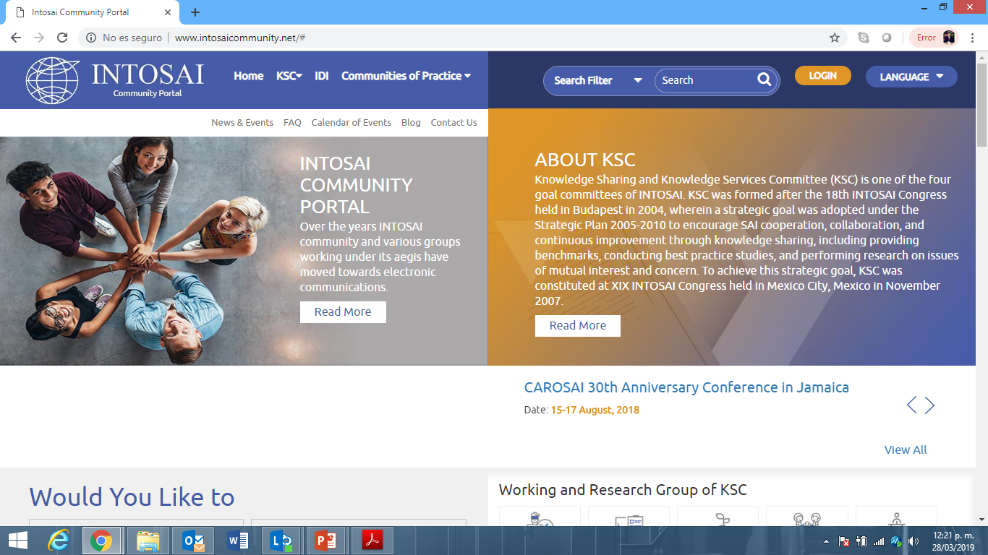
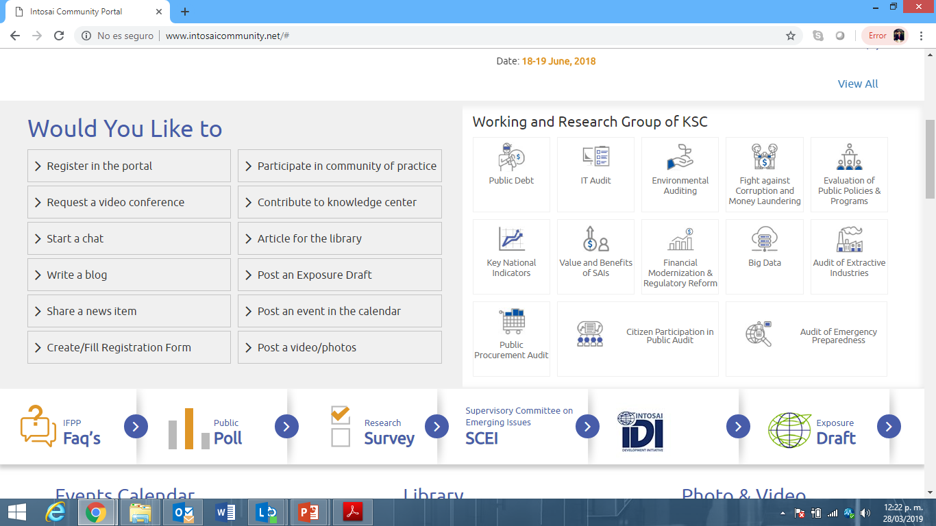
Administrative Matters WGVBS website transition
www.intosaicommunity.net

Slide 11
Administrative Matters Next WGVBS meetings
2020: SAI of Kuwait
2021: SAI of Hungary

Slide 12
Administrative Matters 2020 Meeting - Kuwait
Meeting to be hosted by Mr. Adel Abdulaziz Al-Sarawi, Acting President of the State Audit Bureau of Kuwait
Specific dates to be announced in due time

